Slide 1
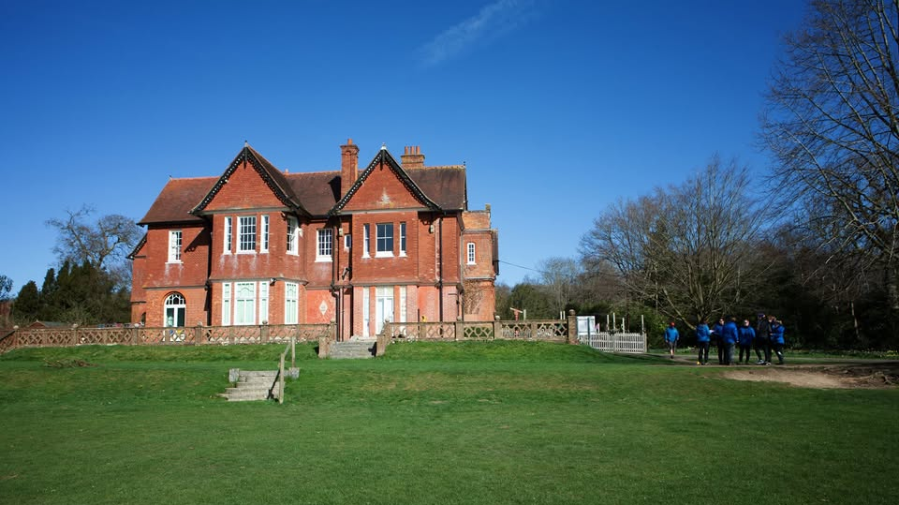
KIT LIST - Fairthorne Manor 2027
• Sunhat or woolly hat
• Sun cream
• Waterproof coat and trousers
• Towels
• Wash kit
• Medication
• Refillable water bottle
• Bin bag for wet or dirty clothes
• Footwear that can get wet and dirty and sturdy shoes such as wellingtons or hiking boots for wearing around site.
•Sleeping bag, pillow and pillowcase
•Fitted sheet for the bed
• Comfortable clothing that can get dirty​
• T-shirts​
• Several sweatshirts / pullovers (lots of thin layers)​
• Shorts and jeans or tracksuit bottoms​
• Spare underclothes and socks
​• Smart casual clothing for the evenings​
• Slippers (indoor accommodation only)​
• Torch​
• Pyjamas​

